Slide 1
The Optimal Boarding & Disembarking Method
IMMC 22768821
Shanghai Experimental School
1

Slide 2
Table of Contents
The Structure of Our Model
Analysis of the Problem
Optimization and Its Applications (Disembarking)
Sensitivity Analysis
Extensions of Our Model
Conclusion & Reflection
2

Slide 3
Part 1 The Structure of Our Model
IMMC22768821
3

Slide 4
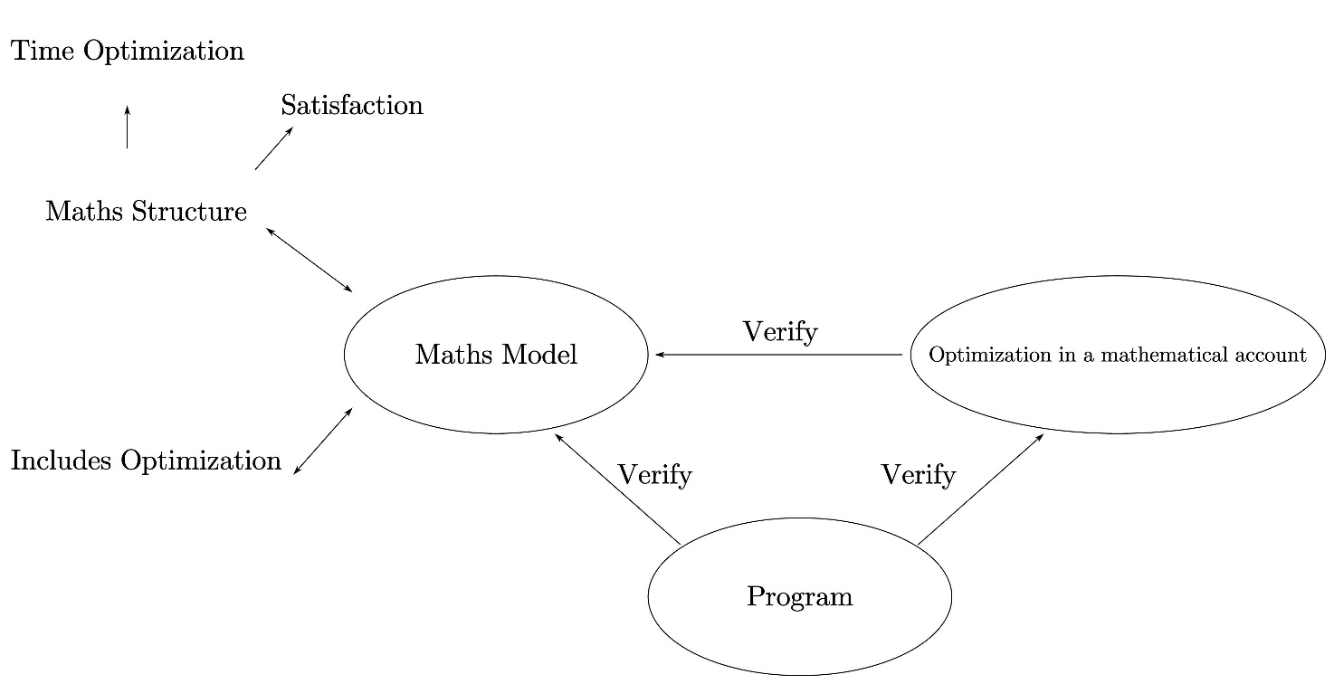
Model Analysis & Structure
What’s new?
Unlike conventional math modelling, mathematical analyses are included in our model.
This added part is mostly theoretical
What for?
It makes our logic more coherent, providing stout justifications for the intuitive notions & concepts raised in our model, as well as the results.
It significantly simplifies tedious calculations, especially during optimization.
It provides plausible strict mathematical explanations for our results.
Fig. The structure of our model
4

Slide 5
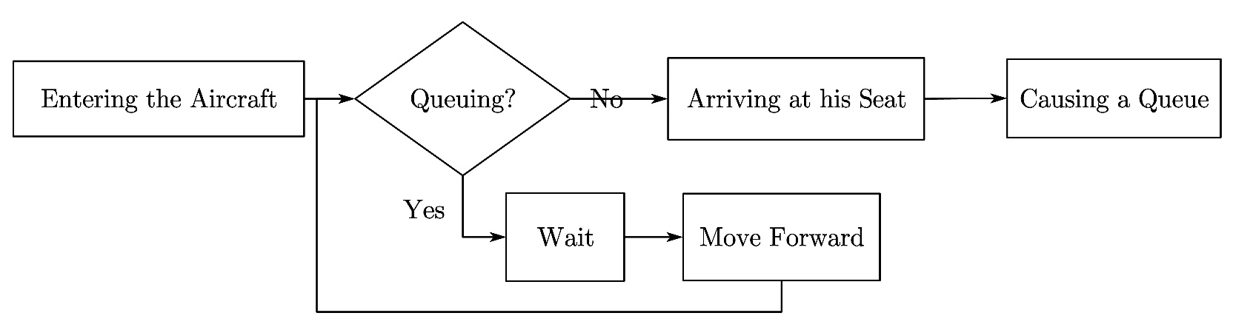
Model Analysis & Structure
Fig. Flow chart of boarding
5

Slide 6
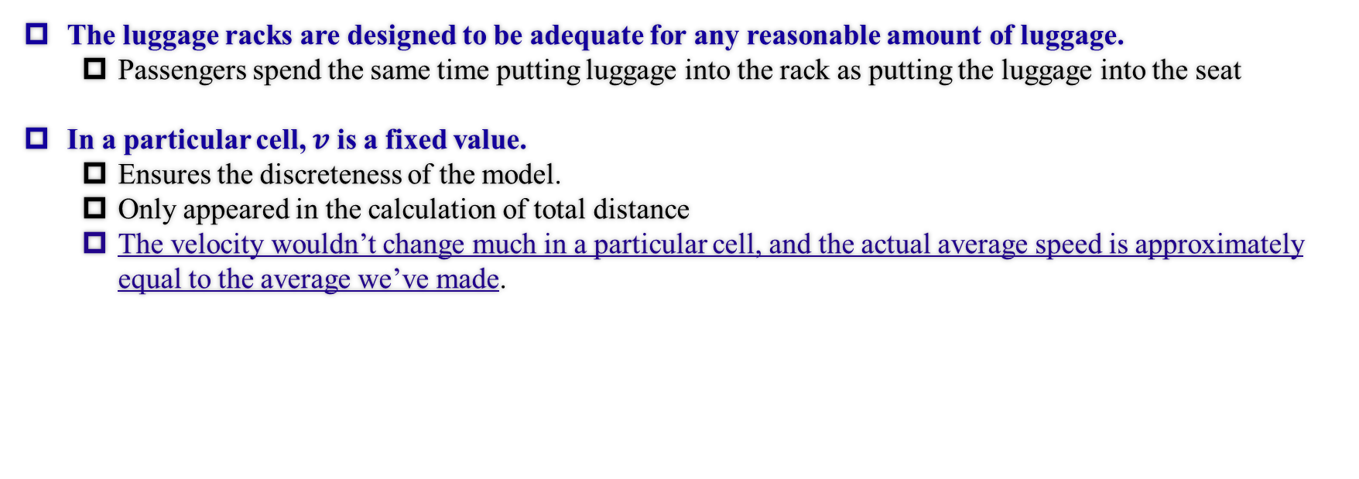
Critical Assumptions
The luggage racks are designed to be adequate for any reasonable amount of luggage.
Passengers spend the same time putting luggage into the rack as putting the luggage into the seat
In a particular cell, $v$ is a fixed value.
Ensures the discreteness of the model.
Only appeared in the calculation of total distance
The velocity wouldn’t change much in a particular cell, and the actual average speed is approximately equal to the average we’ve made.
6

Slide 7
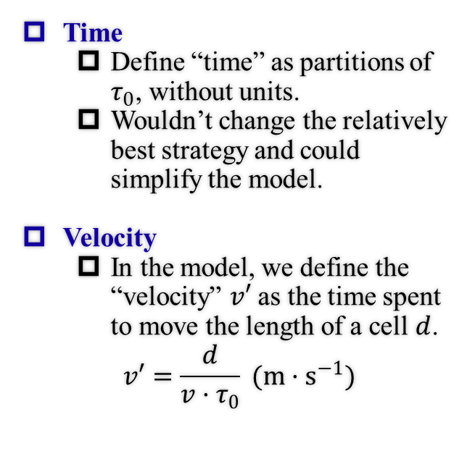
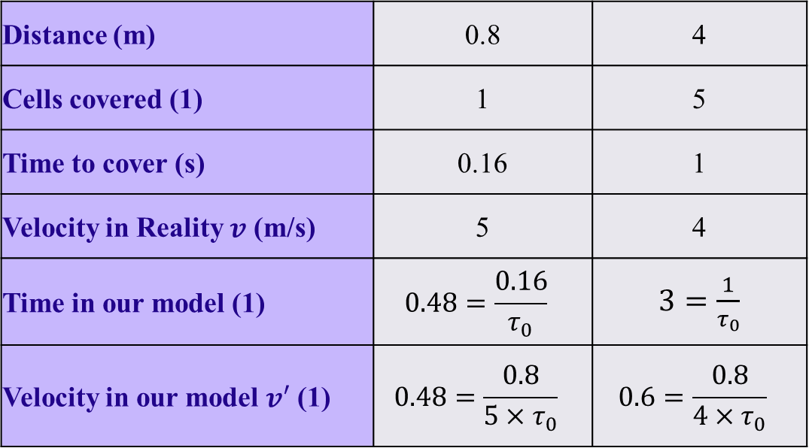
Definitions
Time
Define “time” as partitions of $τ_{0}$, without units.
Wouldn’t change the relatively best strategy and could simplify the model.
Velocity
In the model, we define the “velocity” $v′$ as the time spent to move the length of a cell $d$.
$$v′=\frac{d}{v·τ_{0}} (m·s^{−1})$$
Examples of our definitions for time and velocity
Distance (m) | 0.8 | 4
Cells covered (1) | 1 | 5
Time to cover (s) | 0.16 | 1
Velocity in Reality $v$ (m/s) | 5 | 4
Time in our model (1) | $$0.48=\frac{0.16}{τ_{0}}$$ | $3=\frac{1}{τ_{0}}$
Velocity in our model $v′$ (1) | $$0.48=\frac{0.8}{5×τ_{0}}$$ | $$0.6=\frac{0.8}{4×τ_{0}}$$
7

Slide 8
Part 2 Analysis of the Problem
IMMC22768821
8

Slide 9
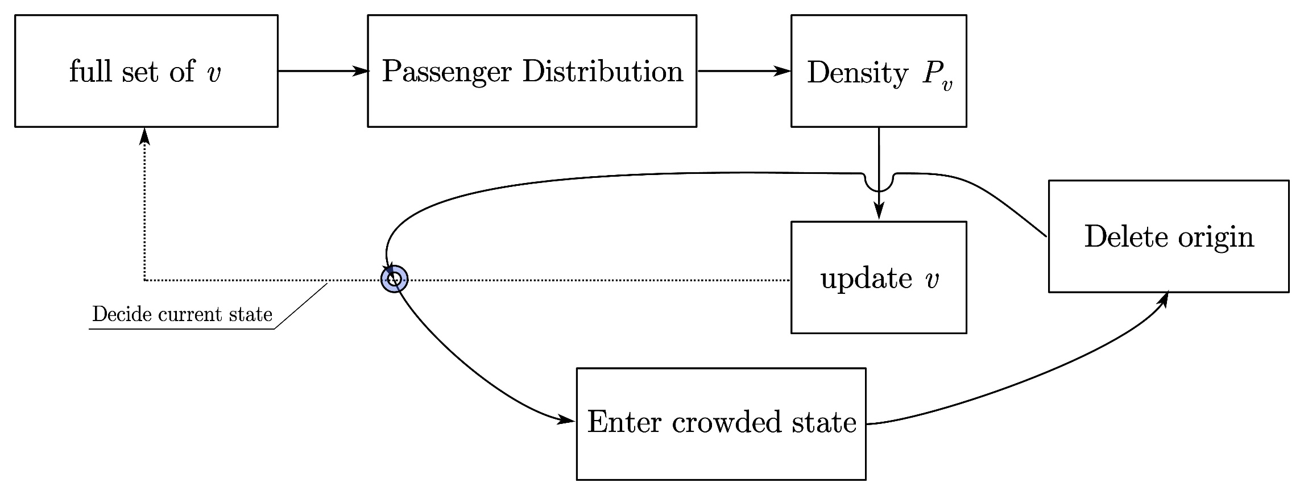
Overview of Math Model
Fig. Overview of our model
9

Slide 10
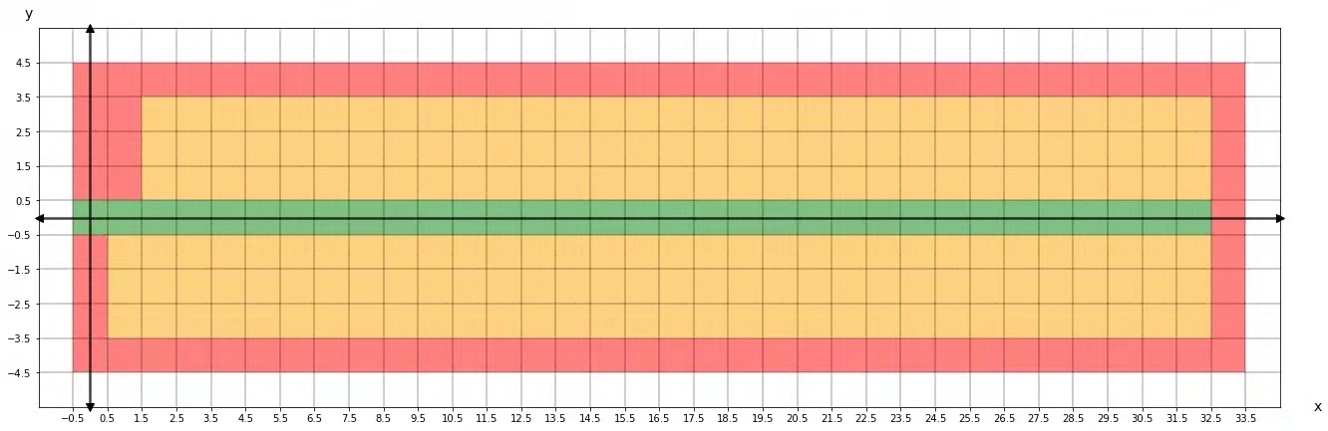
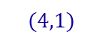
Total Boarding Time (Under Regular States)
The construction of the coordinate
One-dimensional meshed finite element analysis
$$(4,1)$$
Cell 1
Cell 2
Fig. The construction of the coordinate
For example, this wall is still taken as several cells.
10

Slide 11

Total Boarding Time (Under Regular States)
Calculating passengers’ speed with the crowd density
The crowd density defined in our model
The reason for taking 4 as the visibility range
4 cells combined have a moderate range of 3.2 metres, which is also quite realistic.
In our model, the visibility range simultaneously affects the interval in our algorithm. Therefore, choosing 4 as the visibility range can avoid unnecessary complexity.
11

Slide 12
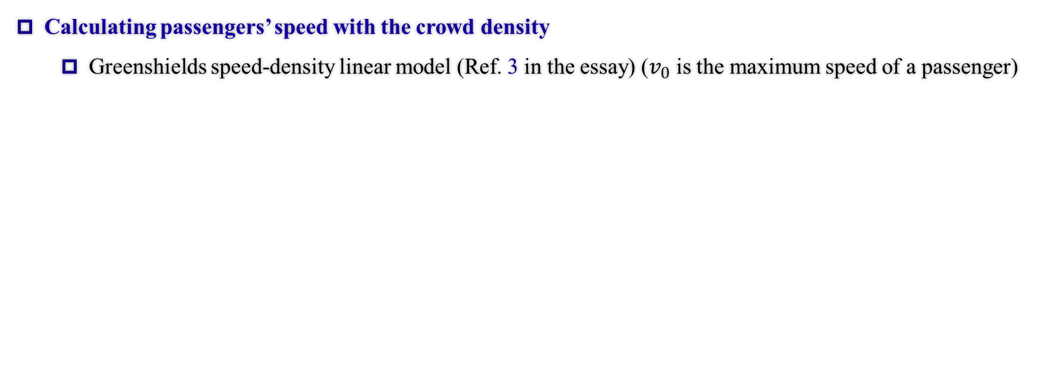
Total Boarding Time (Under Regular States)
Calculating passengers’ speed with the crowd density
Greenshields speed-density linear model (Ref. 3 in the essay) ($v_{0}$ is the maximum speed of a passenger)
12

Slide 13
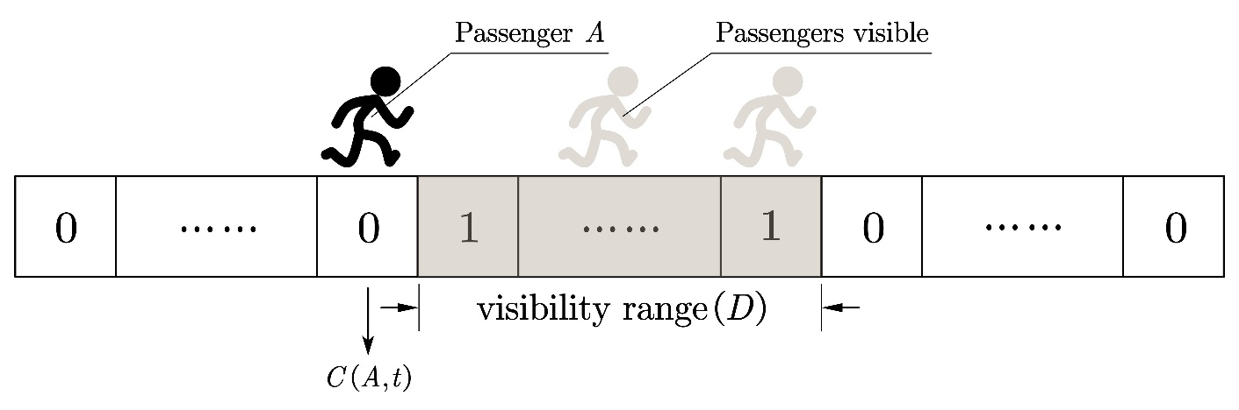
Total Boarding Time (Under Regular States)
Calculating crowd density under a given passenger distribution
Calculated through the dot product of two vectors representing the passenger’s visibility and the overall distribution in the aisle. (or the existence factor)
Fig. The intuitive illustration of the visibility and existence vectors
13

Slide 14
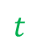
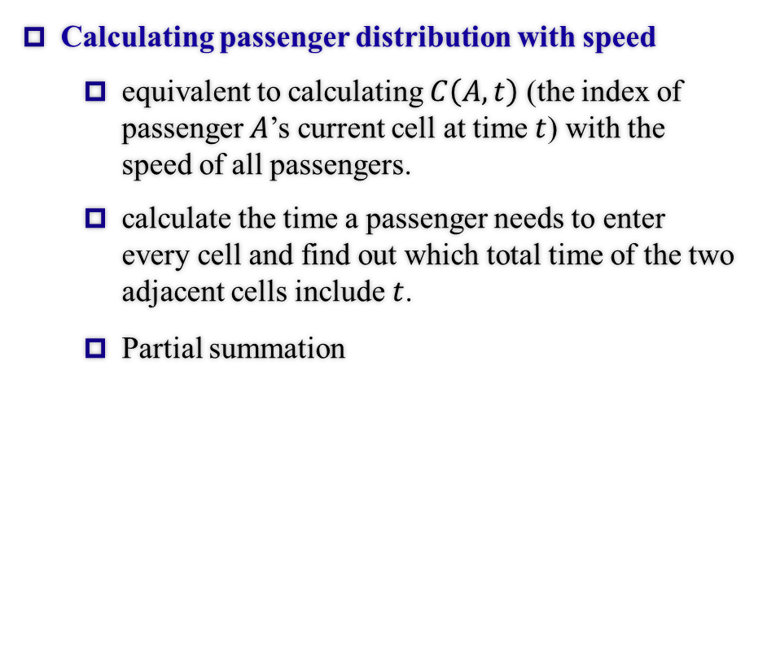

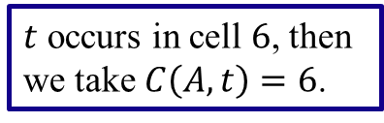
Total Boarding Time (Under Regular States)
Calculating passenger distribution with speed
equivalent to calculating $C\left(A,t\right)$ (the index of passenger $A$’s current cell at time $t$) with the speed of all passengers.
calculate the time a passenger needs to enter every cell and find out which total time of the two adjacent cells include $t$.
Partial summation
1
2
3
4
5
6
7
8
Total time
$t$ occurs in cell $6$, then we take $C\left(A,t\right)=6$.
$$t$$
$$0$$
14

Slide 15
Total Boarding Time (Under Regular States)
The overall recursion formula we get
Our model is linear until the final stage (or the first slide presented in this part), so according to the inverse proportional relationship between real-life velocity and the velocity in our model, we’ll get a linear model. (this quality will be verified later in the Sensitivity Analysis part)
We did some algebraic simplifications and the final recursive result of the velocity can be written as below: (To simplify the variables, we abstract it into the form of linear combinations.)
Although the mathematical simplifications might seem trivial, but this equation provides is THE FUNDAMENTAL BEDROCK for all the analyses & optimization afterwards.
15

Slide 16
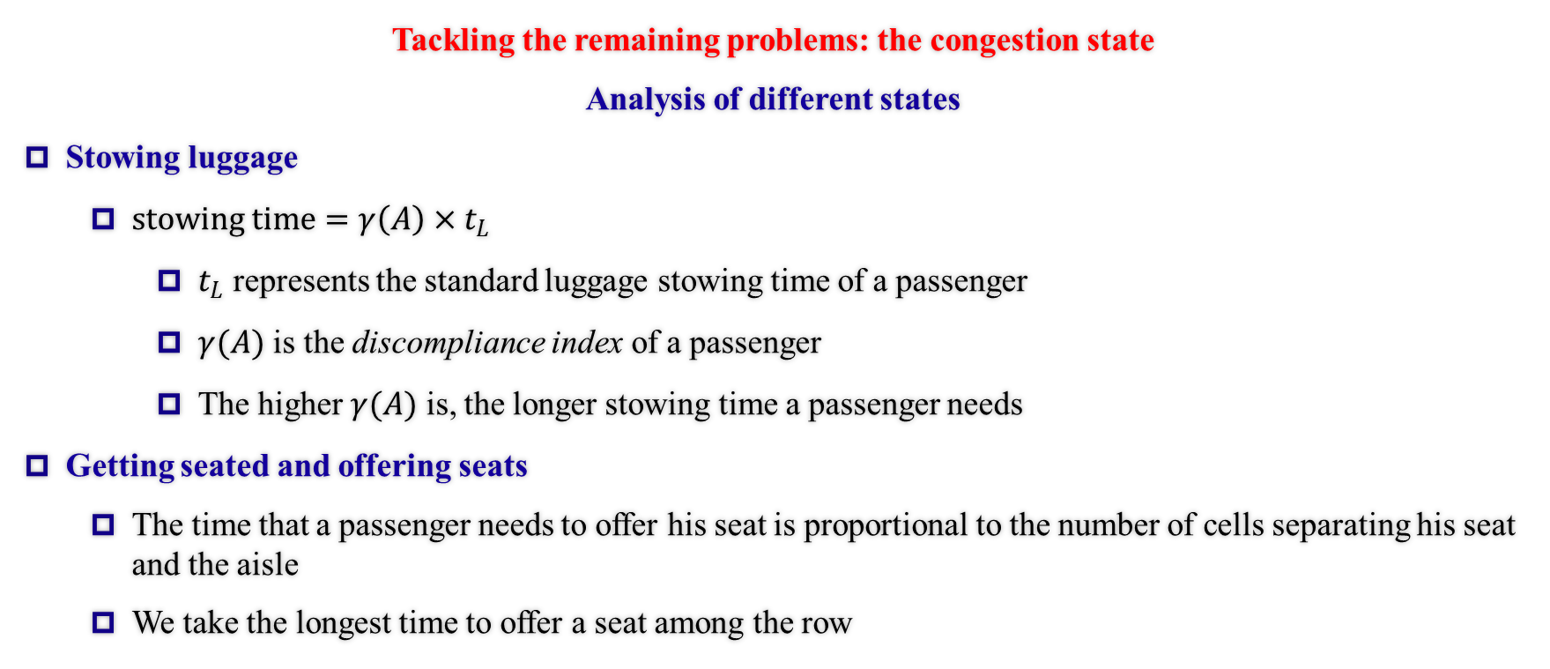
Total Boarding Time (Under Crowded States)
Tackling the remaining problems: the congestion state
Analysis of different states
Stowing luggage
$stowing time=γ\left(A\right)×t_{L}$
$t_{L}$ represents the standard luggage stowing time of a passenger
$γ(A)$ is the discompliance index of a passenger
The higher $γ(A)$ is, the longer stowing time a passenger needs
Getting seated and offering seats
The time that a passenger needs to offer his seat is proportional to the number of cells separating his seat and the aisle
We take the longest time to offer a seat among the row
16

Slide 17
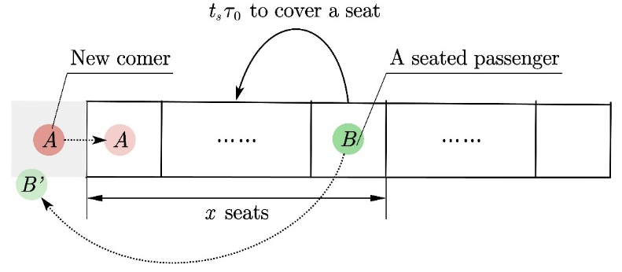
Total Boarding Time (Under Crowded States)
Tackling the remaining problems: the congestion state
Analysis of different states
Getting seated and offering seats
The time to offer seats can be calculated once given the original queue.
Reason – the preservation of sequence in the queue.
Fig. Offering a seat
17

Slide 18
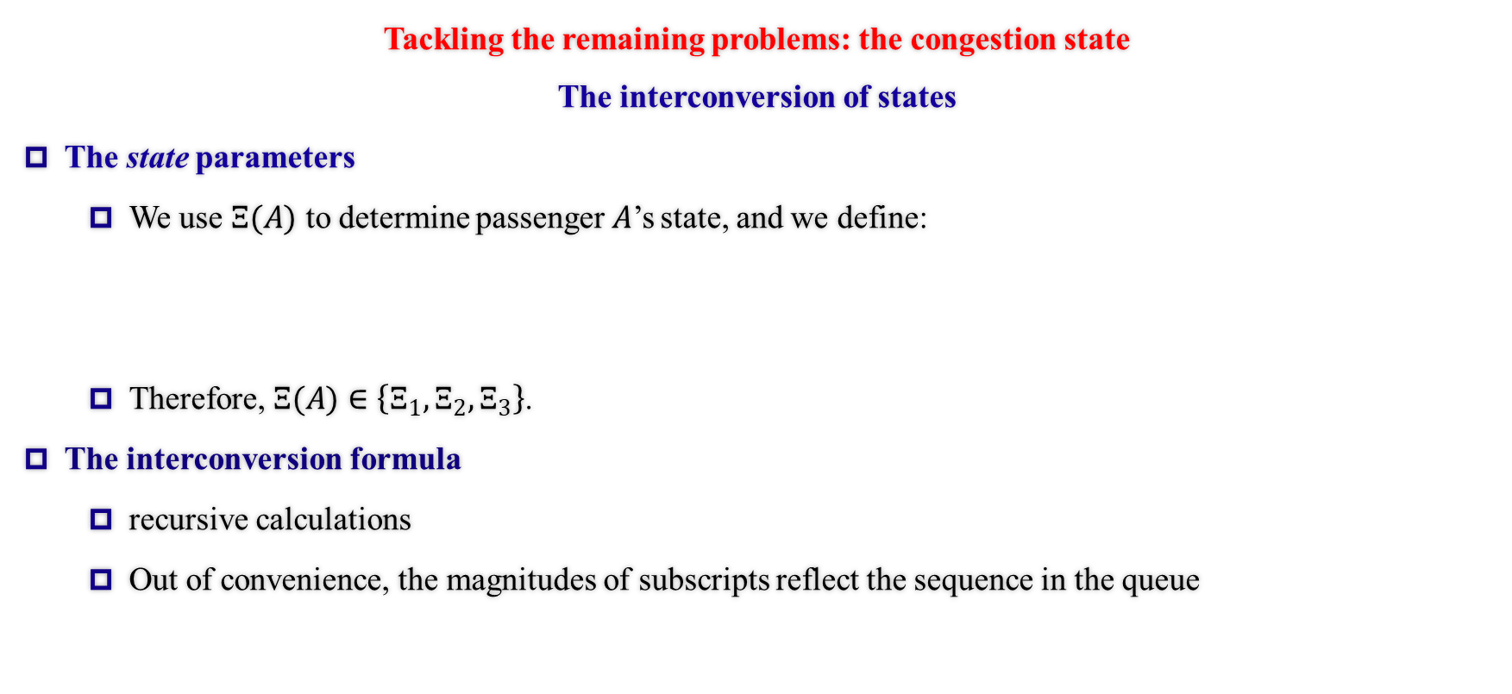
Total Boarding Time (Under Crowded States)
Tackling the remaining problems: the congestion state
The interconversion of states
The state parameters
We use $Ξ(A)$ to determine passenger$A$’s state, and we define:
Therefore, $Ξ(A)∈\left\{Ξ_{1}, Ξ_{2},Ξ_{3}\right\}$.
The interconversion formula
recursive calculations
Out of convenience, the magnitudes of subscripts reflect the sequence in the queue
18

Slide 19
Total Boarding Time (Under Crowded States)
Tackling the remaining problems: the congestion state
The interconversion of states
The interconversion formula
We used the following method to update the states.
Below is shown the mechanism, which fits our flow chart as shown in the beginning.
It’s clear that the relationship remains linear. (Matrix multiplications)
19

Slide 20
Total Boarding Time (Under Crowded States)
Tackling the remaining problems: the congestion state
The interconversion of states
Deleting from the queue
When a passenger reaches his seat, we delete him from the queue to update and continue with the calculations without affecting the previous algorithm.
20

Slide 21
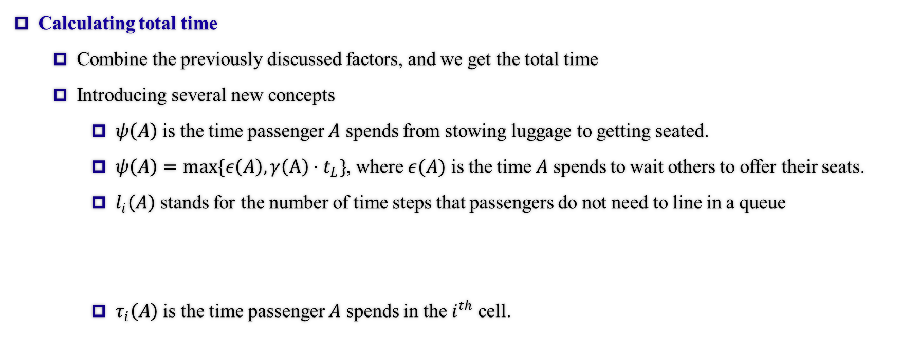
Total Boarding Time (Total time)
Calculating total time
Combine the previously discussed factors, and we get the total time
Introducing several new concepts
$ψ\left(A\right)$ is the time passenger $A$ spends from stowing luggage to getting seated.
$ψ\left(A\right)=max\{ε\left(A\right), γ\left(A\right)⋅t_{L}\}$, where $ε(A)$ is the time $A$ spends to wait others to offer their seats.
$l_{i}\left(A\right)$ stands for the number of time steps that passengers do not need to line in a queue
$τ_{i}\left(A\right)$ is the time passenger $A$ spends in the $i^{th}$ cell.
21

Slide 22
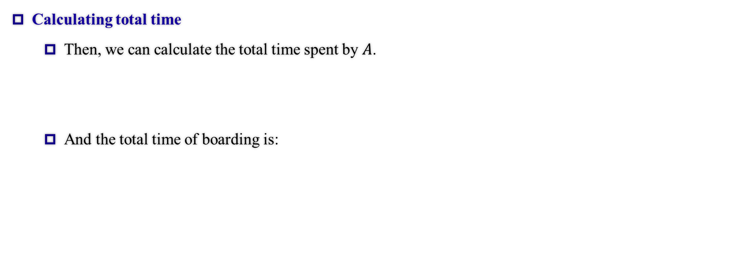
Total Boarding Time (Total time)
Calculating total time
Then, we can calculate the total time spent by $A$.
And the total time of boarding is:
22

Slide 23
Part 3 Optimization and Its Applications (Disembarking)
IMMC22768821
23

Slide 24
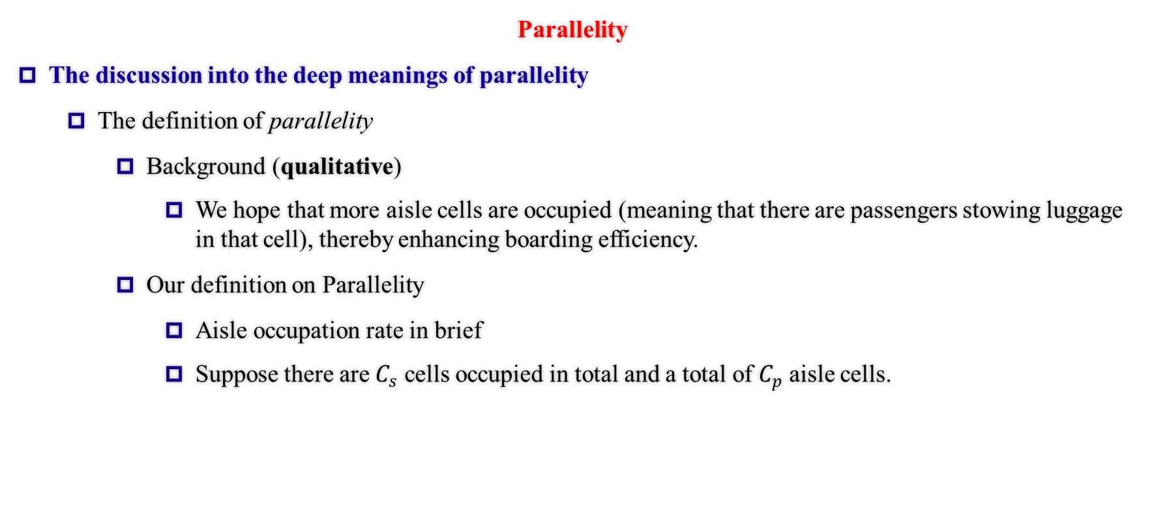
Vertical Optimization (Parallelity)
Parallelity
The discussion into the deep meanings of parallelity
The definition of parallelity
Background (qualitative)
We hope that more aisle cells are occupied (meaning that there are passengers stowing luggage in that cell), thereby enhancing boarding efficiency.
Our definition on Parallelity
Aisle occupation rate in brief
Suppose there are $C_{s}$ cells occupied in total and a total of $C_{p}$ aisle cells.
24

Slide 25
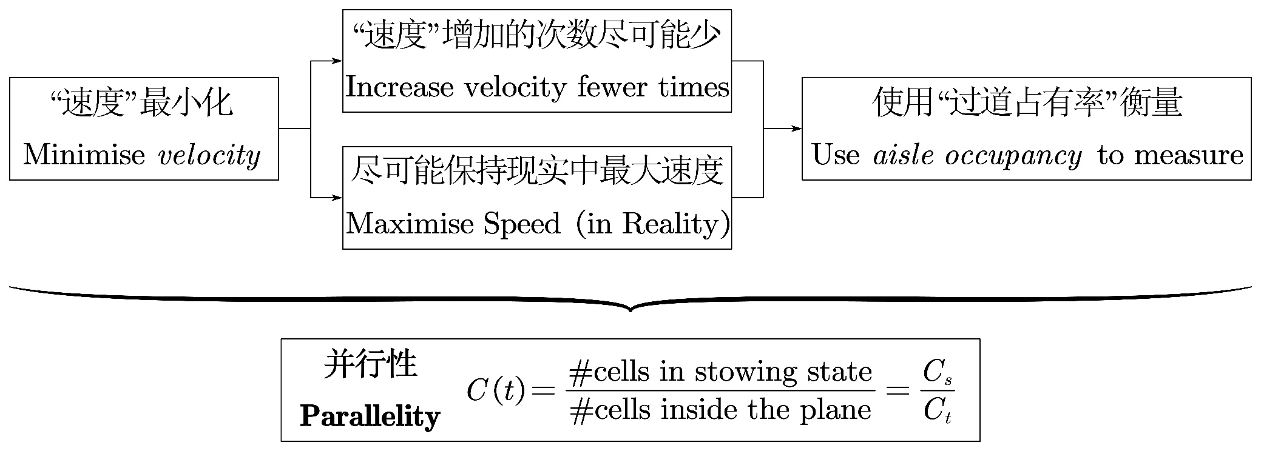
Vertical Optimization (Parallelity)
Parallelity
The discussion into the deep meanings of parallelity
Model basis (semi-quantitative analysis)
25

Slide 26
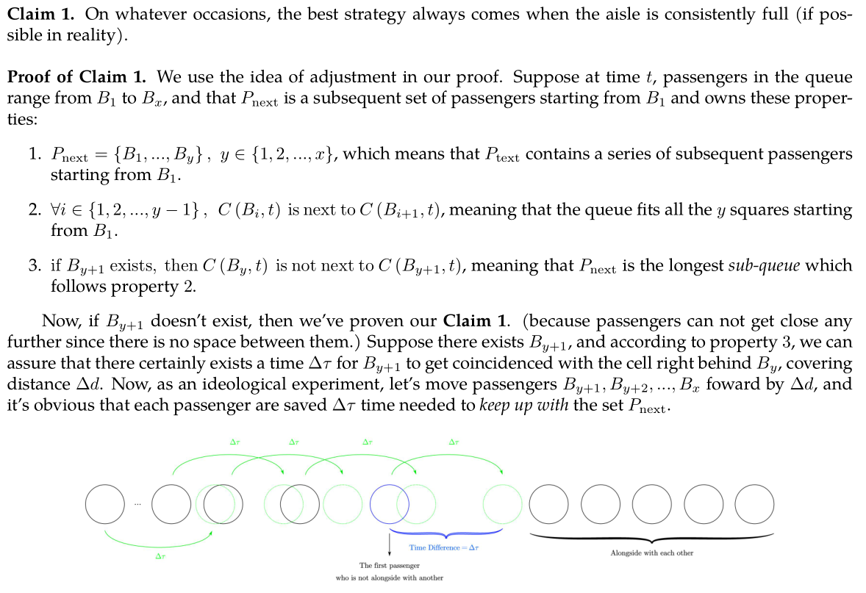
Vertical Optimization (Parallelity)
Parallelity
The discussion into the deep meanings of parallelity
Mathematical deduction (quantitative analysis)
Claim 1 (the optimality of all cells being occupied)
This claim, on the other hand, also justified our model.
the adjustment method & analysis on idealistic circumstances
Claim 2 will appear later in the TETA and Flying Wing part.
We’ll not elaborate on the essay-based strict proof.
26

Slide 27
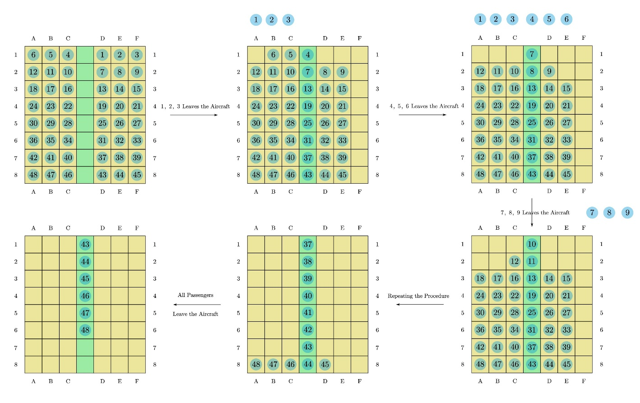
Modelling & Optimization of Disembarking
The starting point and destination of the passengers are exchanged.
The aisles are maximally utilised in terms of parallelity.
There’s no possibility of offering cells, for the aisle is blocked when passengers are getting the luggage out.
Passengers queue as the ideal way, having higher parallelity than boarding. Therefore, the time needed is shorter than boarding.
Fig. The optimal disembarking strategy
27

Slide 28
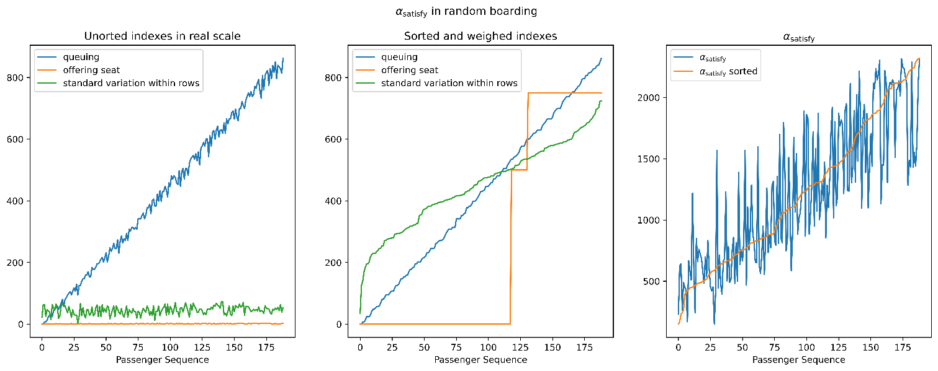
Horizontal Optimization (Satisfactory Index)
Measures the dissatisfaction of passengers.
Queuing time
Time offering seats
Standard variance of the boarding time of same-row passengers
The total dissatisfaction is the weighted sum of the three factors, the weight respectively 1, 250 and 10.
28

Slide 29
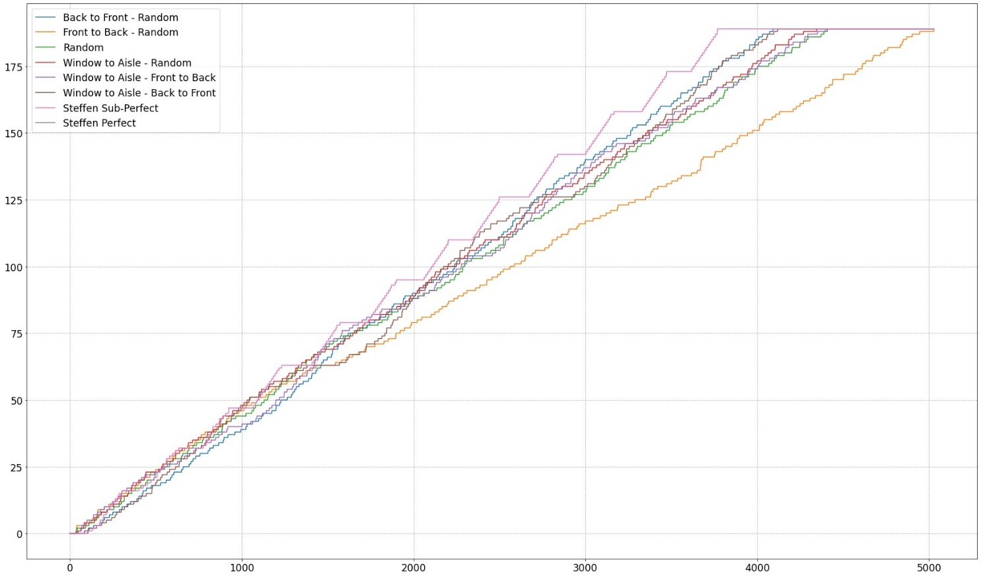
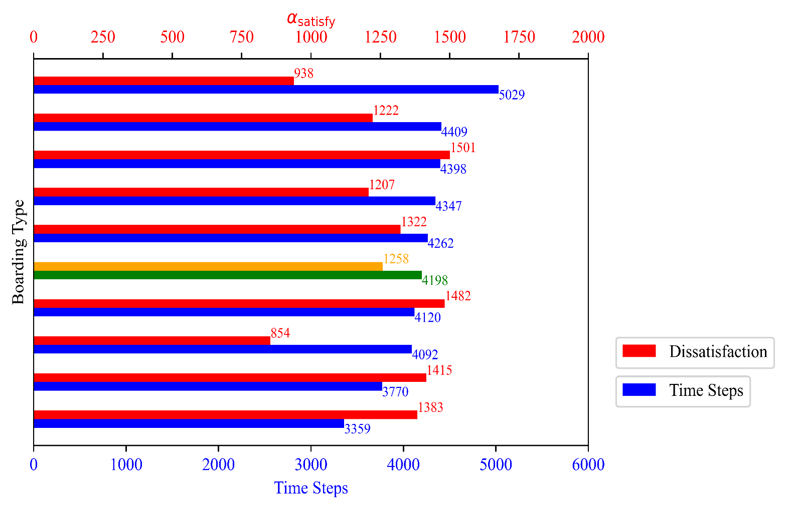
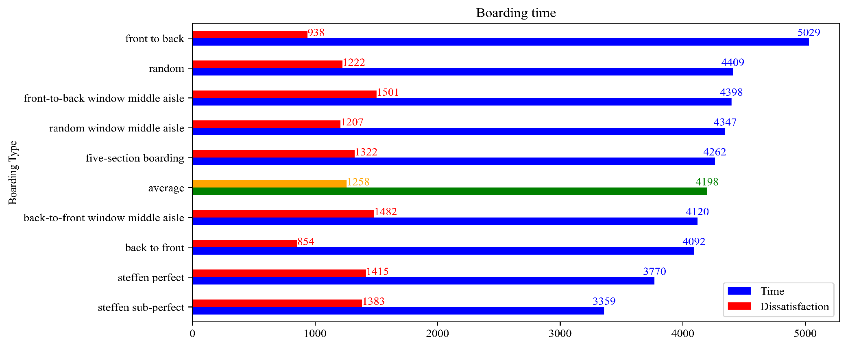
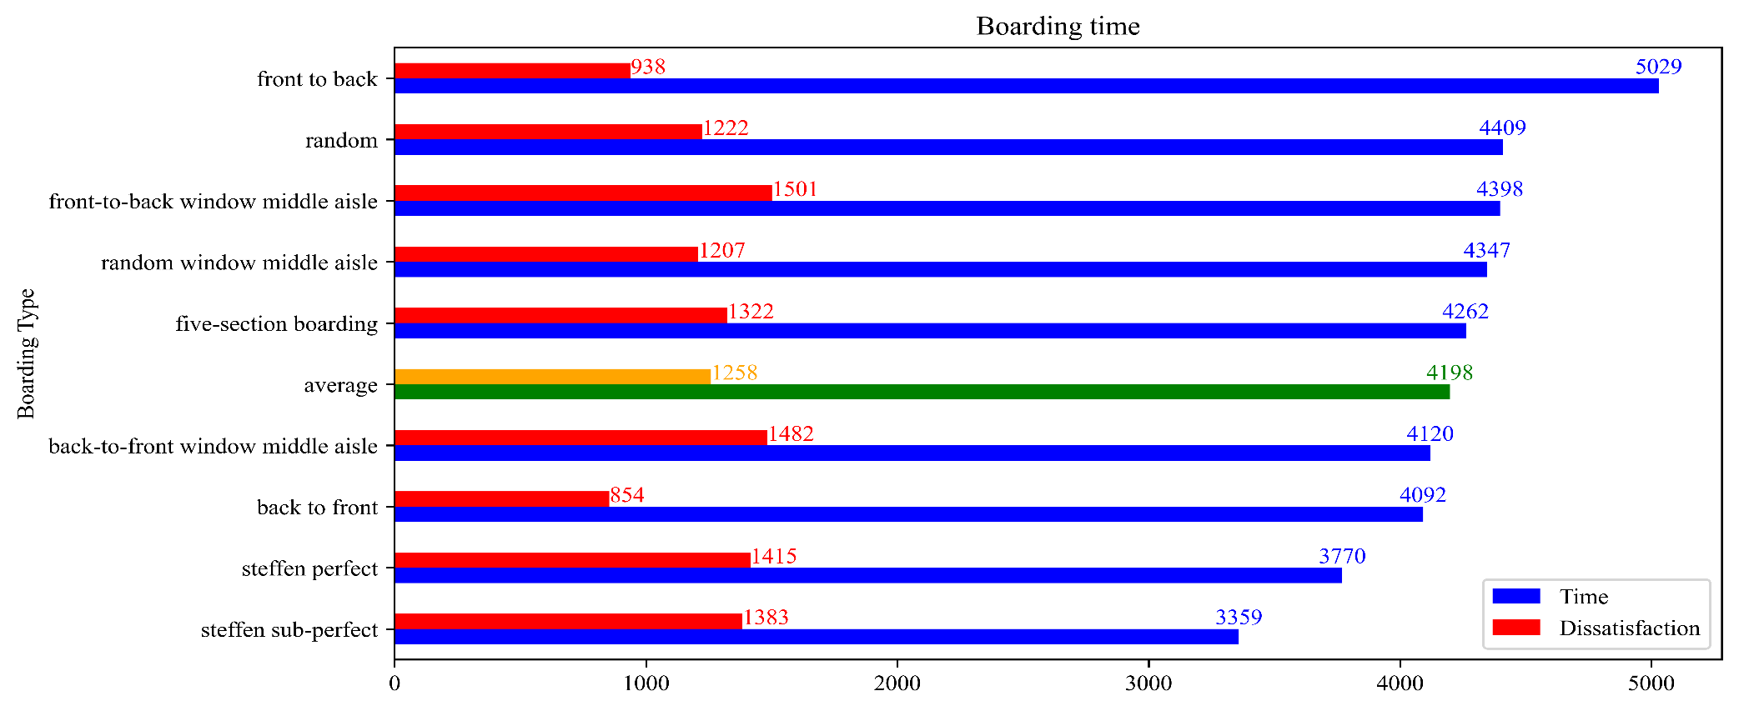


29

Slide 30
Results of Simulation
Shortest time: Steffen Sub-Perfect
Most Satisfactory: Back to Front
30

Slide 31
Part 4 Sensitivity Analysis
IMMC22768821
31

Slide 32
Sensitivity Analysis
Case 1: A Longer Stowing Time
Random boarding is the most sensitive while Front-to-Back method seems totally not sensitive
Case 2: Queue Jumping
Both Methods are Sensitive which makes a Big Impact on Total Results
Case 3: Reduction of Passengers
Random Boarding is the most Sensitive (Furthest Distribution of Points), Back-to-Front Method still not so sensitive
32

Slide 33
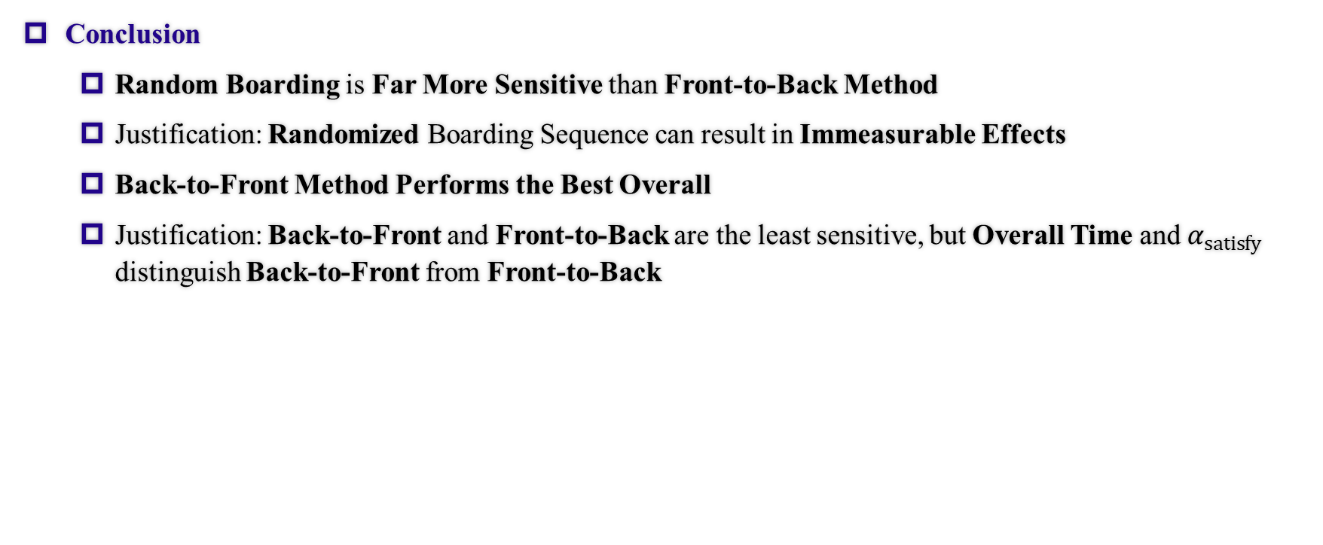
Sensitivity Analysis
Conclusion
Random Boarding is Far More Sensitive than Front-to-Back Method
Justification: Randomized Boarding Sequence can result in Immeasurable Effects
Back-to-Front Method Performs the Best Overall
Justification: Back-to-Front and Front-to-Back are the least sensitive, but Overall Time and $α_{satisfy}$ distinguish Back-to-Front from Front-to-Back
33

Slide 34
Part 5 Extensions of Our Model
IMMC22768821
34

Slide 35
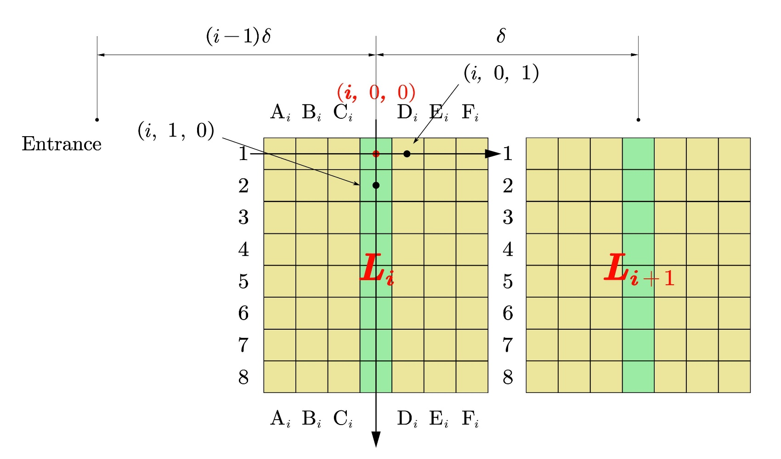
Application to Different Aircrafts (Coordinates)
Flying Wing Aircraft
We adopted three-dimensional coordinates.
We see every block as independent parts
Main Aisle Cells
Block Aisle Cells
Fig. Division of coordinates in Flying Wing
35

Slide 36
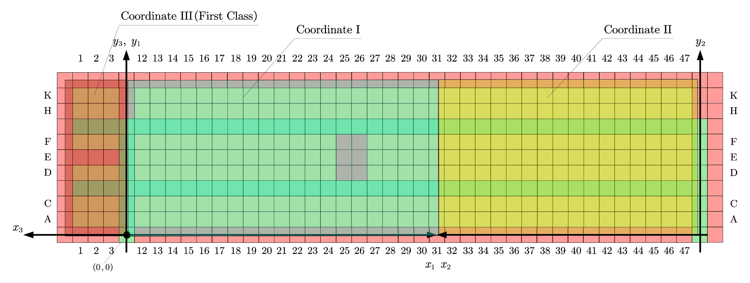
Application to Different Aircrafts (Coordinates)
Fig. Division of coordinates in TETA
36

Slide 37
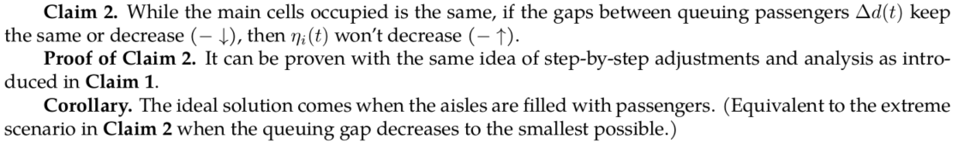
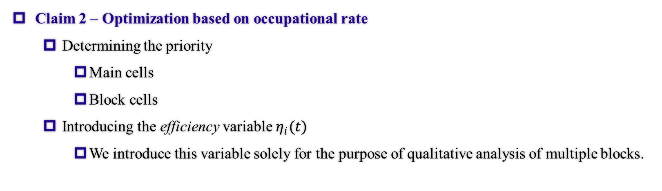
Application to Different Aircrafts (Optimisation)
Claim 2 – Optimization based on occupational rate
Determining the priority
Main cells
Block cells
Introducing the efficiency variable $η_{i}(t)$
We introduce this variable solely for the purpose of qualitative analysis of multiple blocks.
37

Slide 38
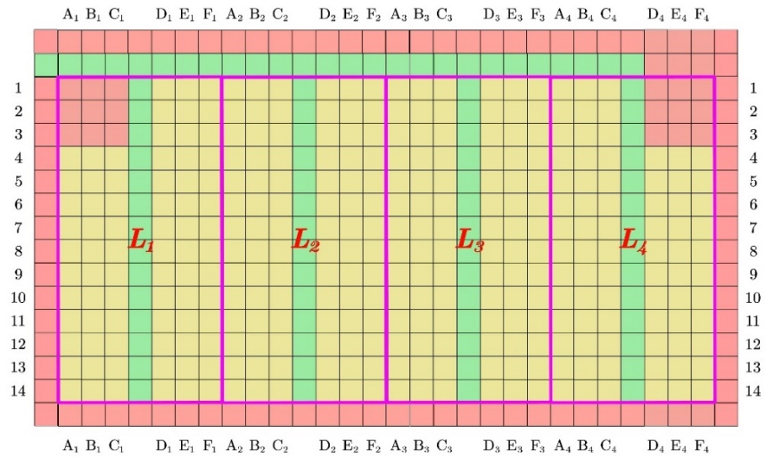
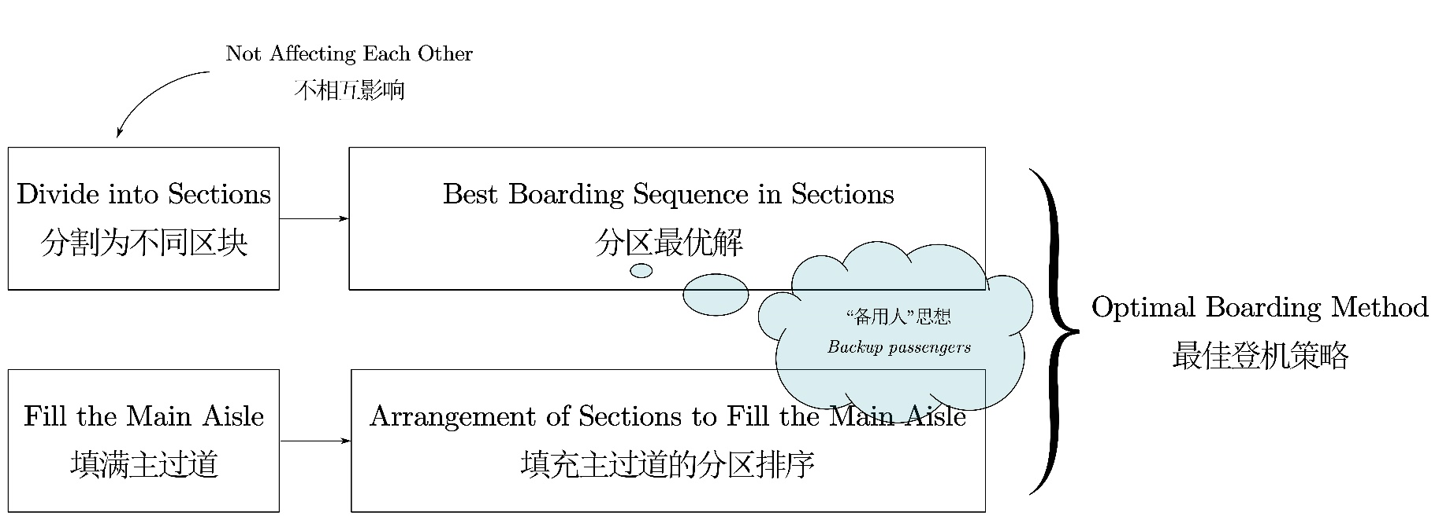
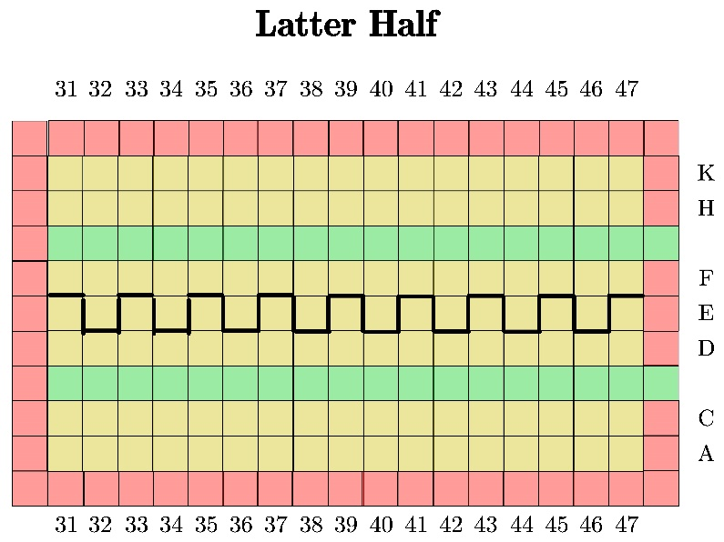
Application to Different Aircrafts (Optimisation)
Fig. Flow chart for the optimal boarding method
Two block division schemes
38

Slide 39
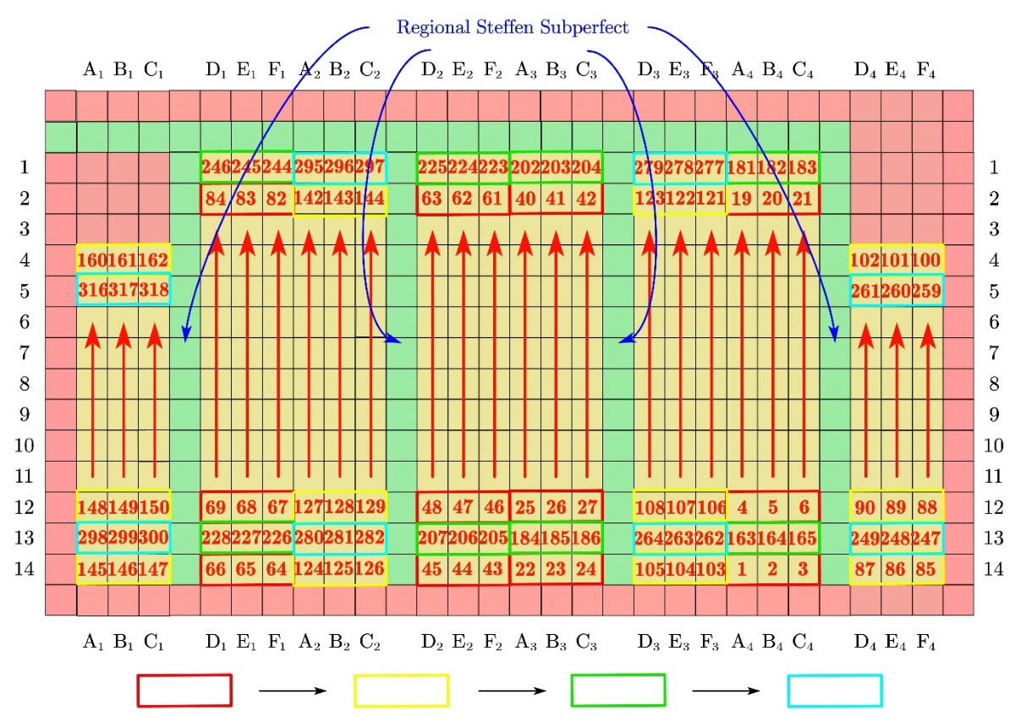
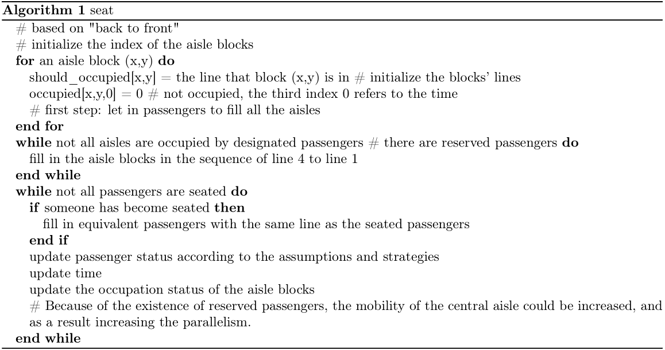
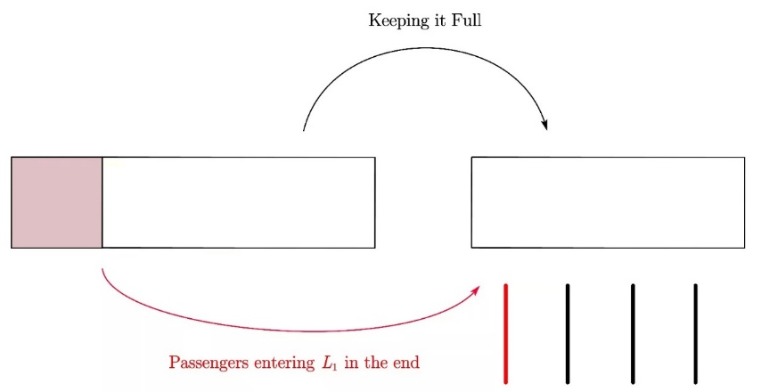
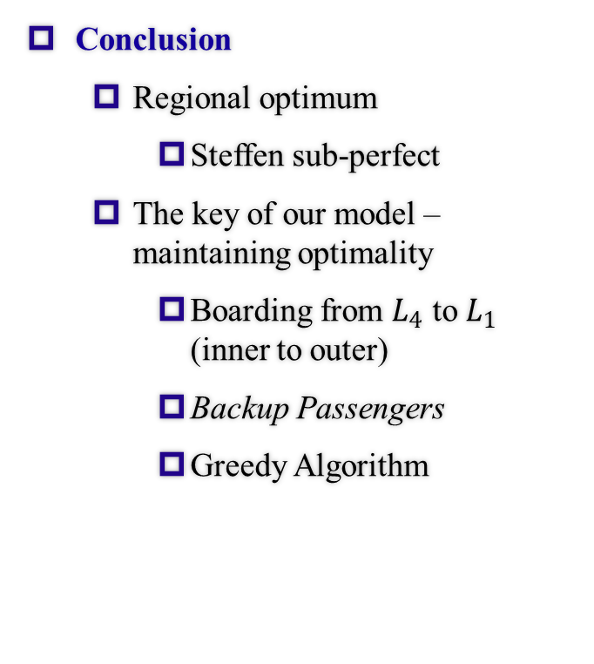
Application to Different Aircrafts (Conclusions)
Conclusion
Regional optimum
Steffen sub-perfect
The key of our model – maintaining optimality
Boarding from $L_{4}$ to $L_{1}$ (inner to outer)
Backup Passengers
Greedy Algorithm
Fig. Ideal Boarding Scheme
39

Slide 40
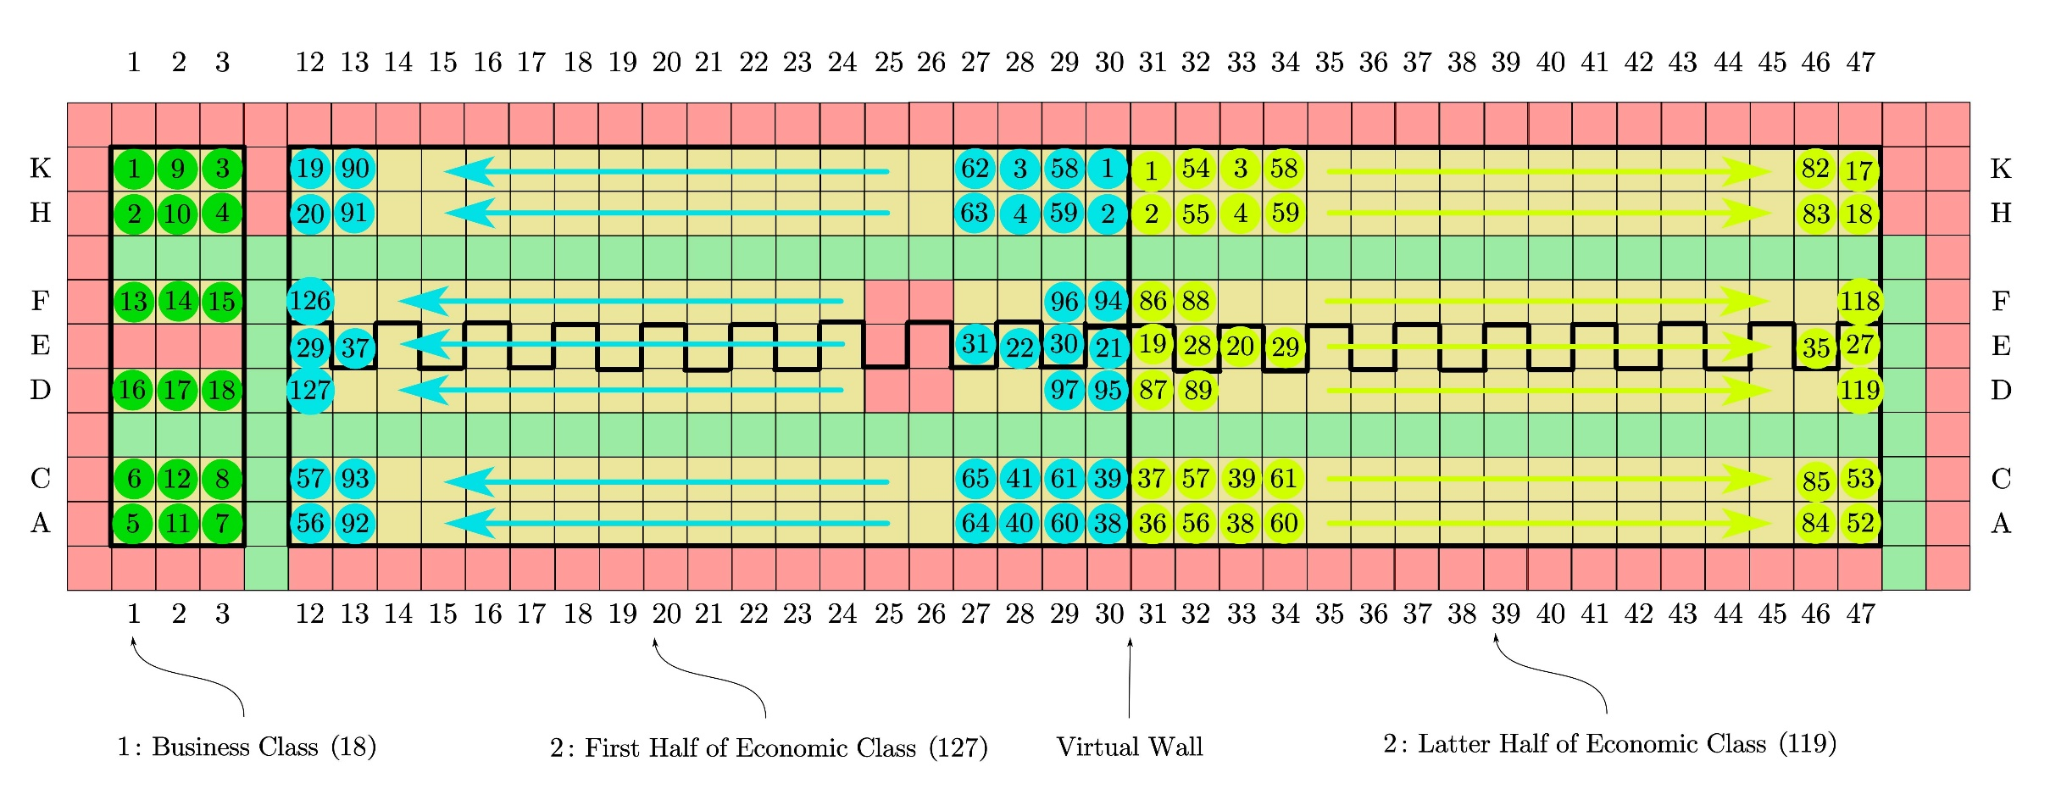
Application to Different Aircrafts (Conclusions)
Conclusion
40

Slide 41
Part 6 Conclusion & Reflection
IMMC22768821
41

Slide 42
Strengths & Weaknesses
Strengths
Accuracy
Universality
Efficiency
Weaknesses
Complexity
Difficult to Operate
42

Slide 43

Thanks For Listening!
SES stOOrz Math Modelling Group
IMMC 22768821
Shanghai Experimental School
43

Slide 44
Part 7 Appendix
IMMC22768821
44

Slide 45
Hyperlinks
Pg. 4 Model Analysis & Structure
Pg. 5 Critical Assumptions
Pg. 6 Definitions
Pg. 8 Overview of Math Model
Pg. 9 Regular States - Coordinates
Pg. 10 Regular States - D -> v
Pg. 11 Regular States - D -> v
Pg. 12 Regular States - Distribution -> D
Pg. 13 Regular States - v -> Distribution
Pg. 14 Regular States - Overall Recursion
Pg. 15 Crowded State - Stowing & Seating
Pg. 16 Crowded State - Seating
Pg. 17 Crowded State - Congestion Parameter
Pg. 18 Crowded State - Interconversion Formula
Pg. 19 Crowded State - Delete
Pg. 20 Total Time
Pg. 21 Total Time
Pg. 23 Vertical Optimization - Parallelity
Pg. 24 Vertical Optimization - Parallelity
Pg. 25 Vertical Optimization - Parallelity
Pg. 26 Disembarking
Pg. 27 Horizontal optimization - Satisfactory Index
Pg. 28 Results Graph
Pg. 29 Results
Pg. 31 SA Results
Pg. 32 SA Conclusion
Pg. 34 Different Aircrafts - Coordinates FW
Pg. 35 Different Aircrafts - Coordinates TETA
Pg. 36 Different Aircrafts - Optimisation
Pg. 37 Different Aircrafts - Optimisation
Pg. 38 Different Aircrafts - Conclusion FW
Pg. 39 Different Aircrafts - Conclusion TETA
Pg. 41 Strengths & Weaknesses
45

Slide 46
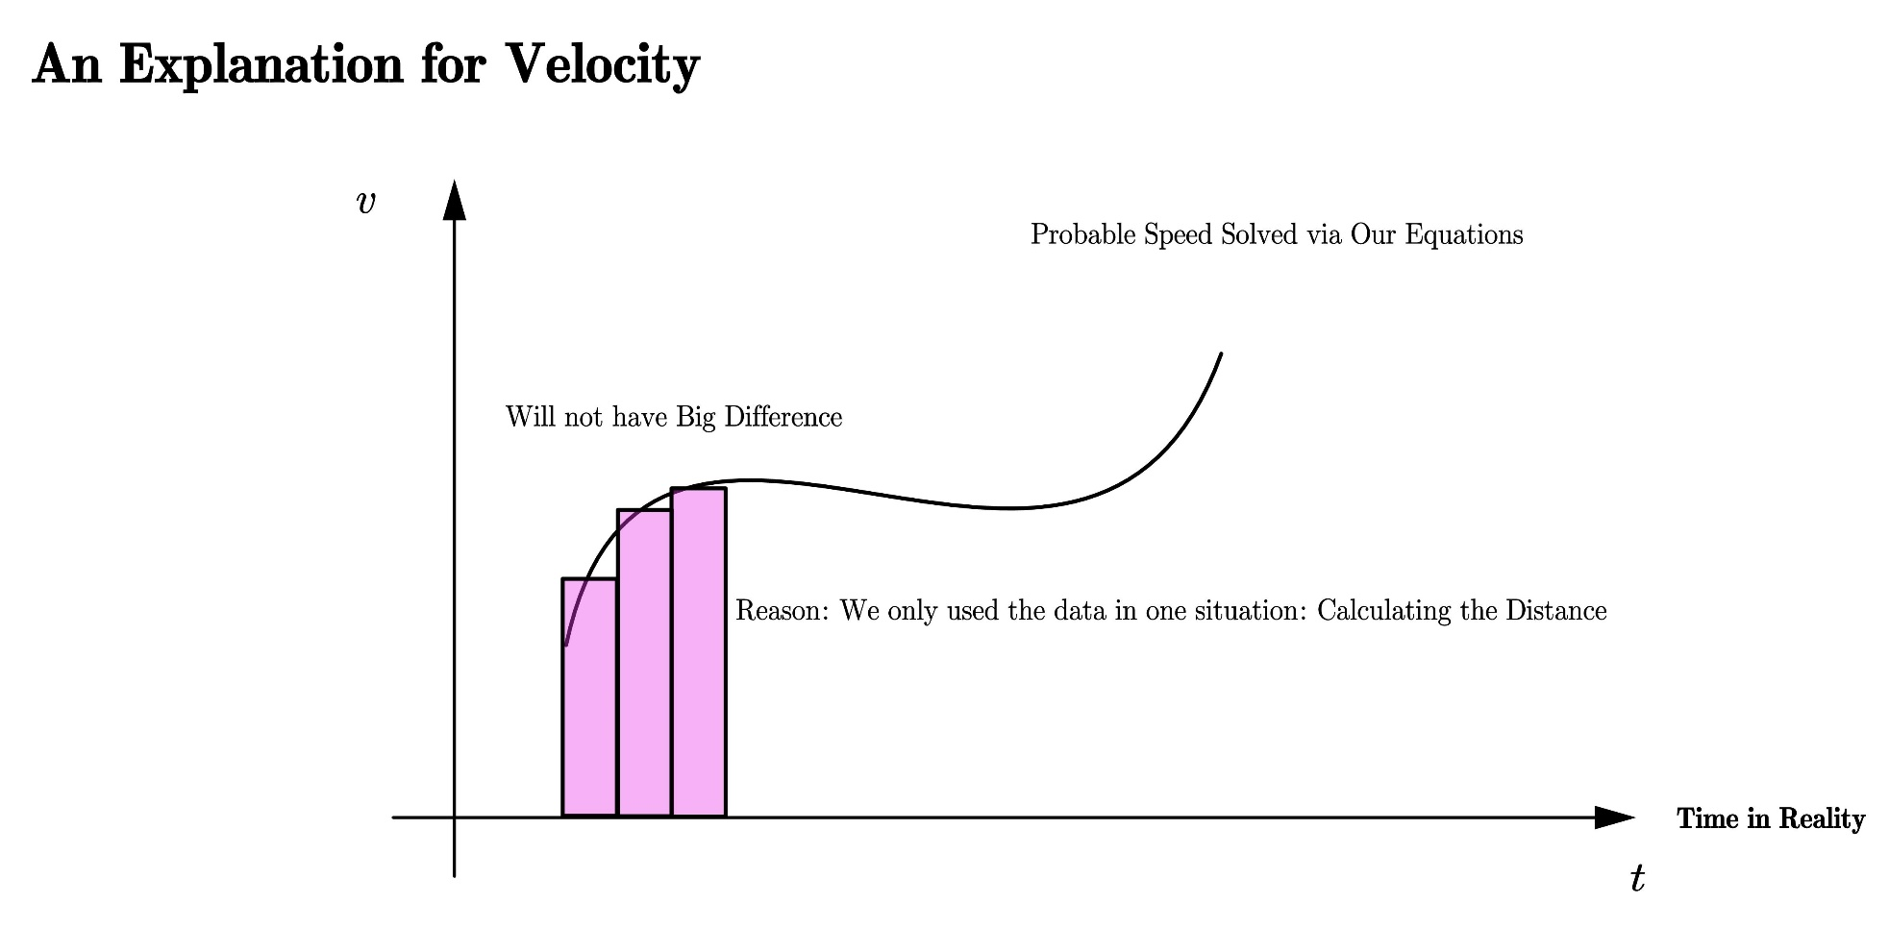
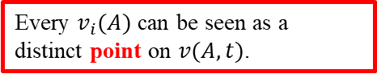
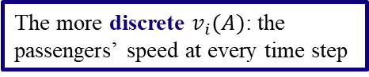
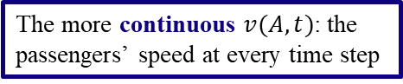
Justification for the Assumption
The explanation for the last assumption made in the previous slide
The more continuous $v(A,t)$: the passengers’ speed at every time step
The more discrete $v_{i}(A)$: the passengers’ speed at every time step
Every $v_{i}(A)$ can be seen as a distinct point on $v(A,t)$.
Therefore, the summation (or integral) of these two defined velocities will roughly amount to the same value.
46

Slide 47
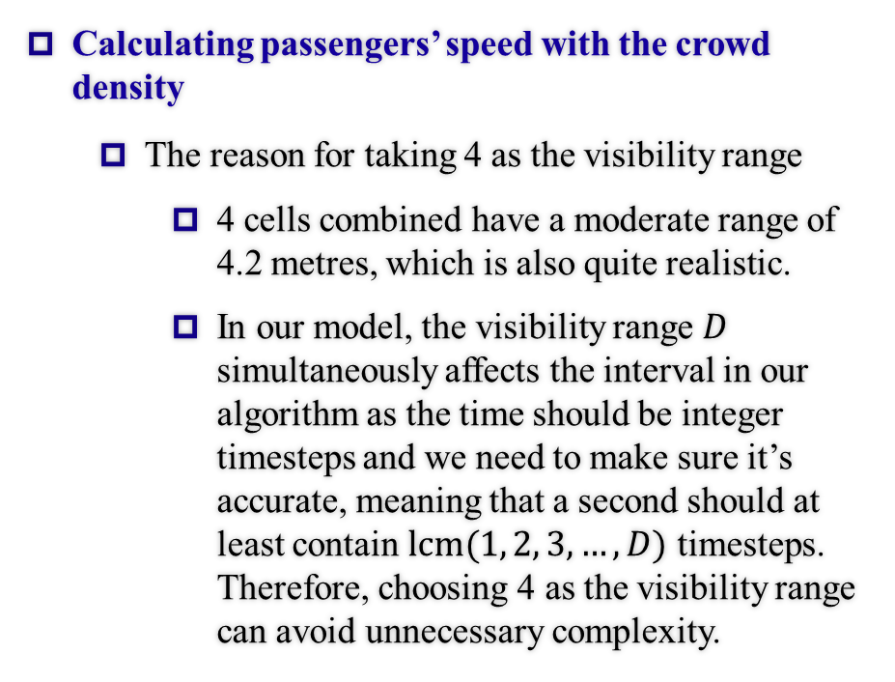
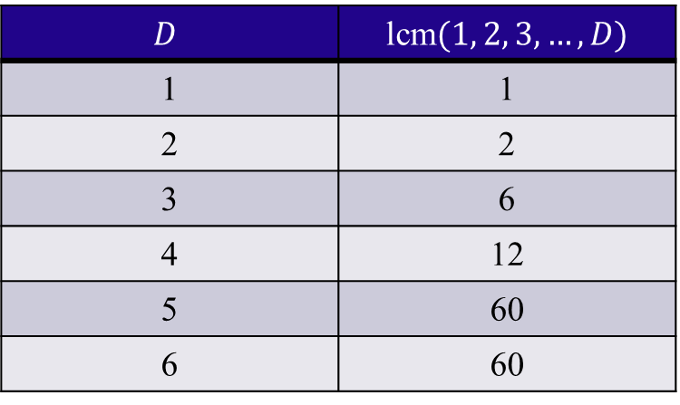
Total Boarding Time (Under Regular States)
Calculating passengers’ speed with the crowd density
The reason for taking 4 as the visibility range
4 cells combined have a moderate range of 4.2 metres, which is also quite realistic.
In our model, the visibility range $D$ simultaneously affects the interval in our algorithm as the time should be integer timesteps and we need to make sure it’s accurate, meaning that a second should at least contain $lcm(1, 2, 3, …, D)$ timesteps. Therefore, choosing 4 as the visibility range can avoid unnecessary complexity.
$$D$$ | lcm$(1, 2, 3, …, D)$
1 | 1
2 | 2
3 | 6
4 | 12
5 | 60
6 | 60

Slide 48
Using Matrixes to Describe Passenger States
Why?
To describe the states mathematically
The originally abstract states of passengers can be quantified
To ensure the linearity
The state Matrix can be calculated from the existing ones according to the recursion formula
48

Slide 49
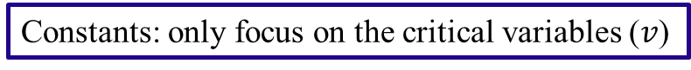
Mathematical (Algebraic) Simplifications
Why?
To make our model direct and clear.
Facilitate our calculation.
Avoid intermediate variables.
Prevent interference of irrelevant coefficients.
Ensure the model’s accuracy.
Facilitate our calculation.
Ensure that the logic of our model is coherent and rigorous.
Make the afterward analyses more intuitive
Lay the foundation for linear construction.
Direct and clear
Constants: only focus on the critical variables ($v$)
49

Slide 50
The essence behind our mathematical model
Make the model bear logic self-consistency.
The process of our model is complete.
Variable-based and accurate.
Make optimization process easy.
All the different occasions have been discussed in our model.
Simple formulas make it easier to be understood.
50

Slide 51
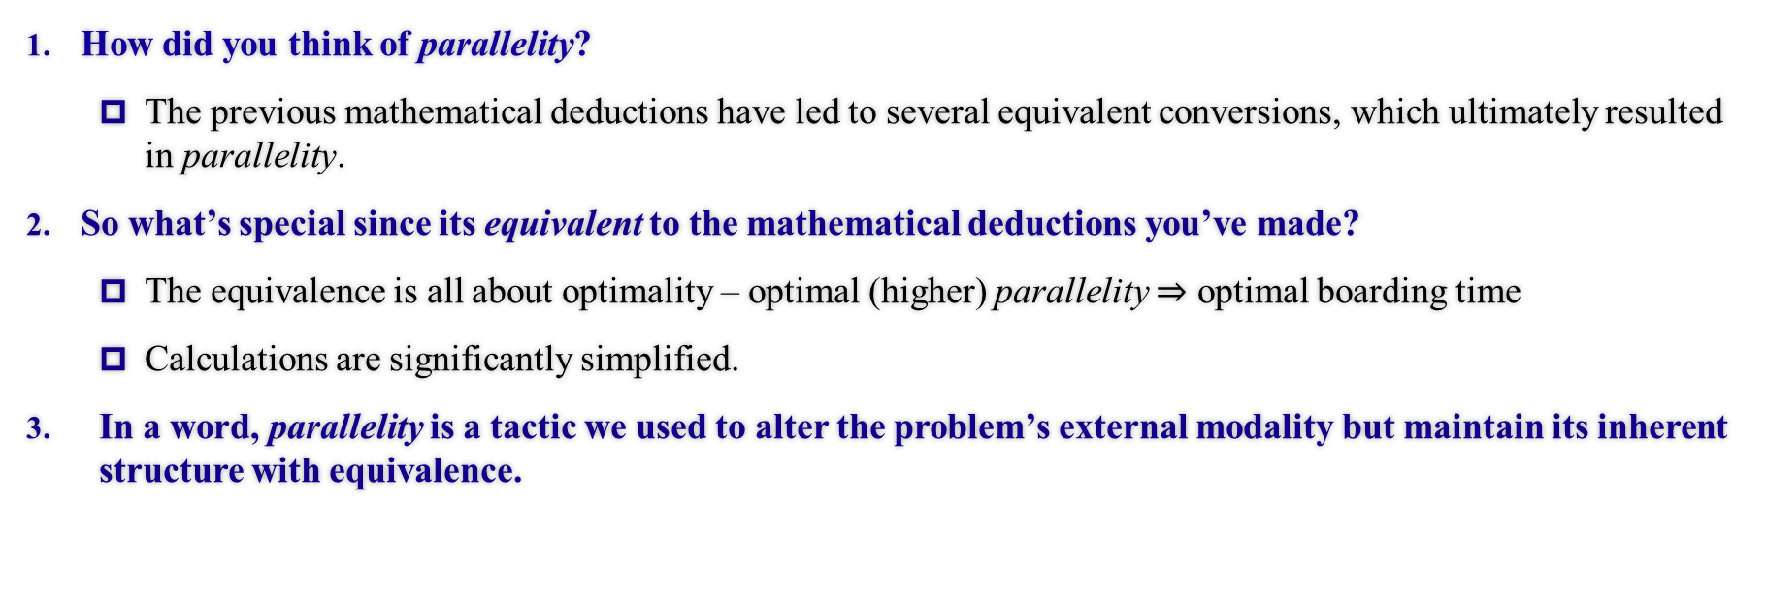
The reasons behind parallelity
How did you think of parallelity?
The previous mathematical deductions have led to several equivalent conversions, which ultimately resulted in parallelity.
So what’s special since its equivalent to the mathematical deductions you’ve made?
The equivalence is all about optimality – optimal (higher) parallelity $⇒$ optimal boarding time
Calculations are significantly simplified.
In a word, parallelity is a tactic we used to alter the problem’s external modality but maintain its inherent structure with equivalence.
51

Slide 52
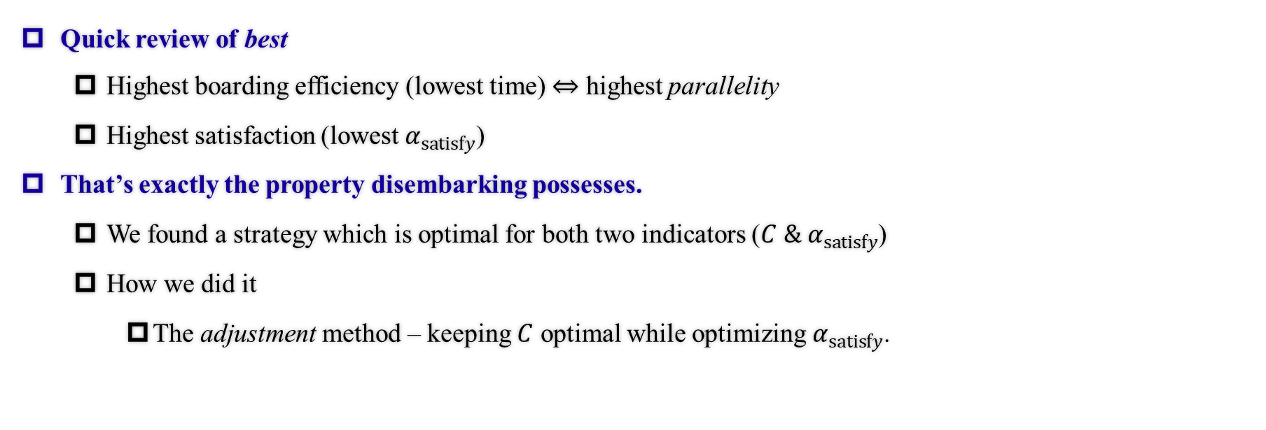
The core of the disembarking task
Quick review of best
Highest boarding efficiency (lowest time) $⇔$ highest parallelity
Highest satisfaction (lowest $α_{satisfy}$)
That’s exactly the property disembarking possesses.
We found a strategy which is optimal for both two indicators ($C \&{ α}_{satisfy}$)
How we did it
The adjustment method – keeping $C$ optimal while optimizing $α_{satisfy}$.
What if these two requisites are met simultaneously?
Queuing time
Time offering seats
Standard variance of the boarding time of same-row passengers
52

Slide 53
Horizontal Optimization (Satisfactory Index)
What does the third factor stand for?
Queuing time
Time offering seats
Standard variance of the boarding time of same-row passengers
Families (or fellow passengers) may be separated
It was not directly shown in the essay, so we point this out for your reference.
Why 1, 250 and 10?
1 is for standardisation
Unite magnitudes & importance
Once united the magnitudes, the dissatisfaction index can rather equally reflect the three aspects of passengers’ satisfaction instead of tending to one of them.
It can make the ultimate dissatisfaction index of all passengers linear and plausible.
53

Slide 54
Sensitivity Analysis
How to conduct a Sensitivity Analysis on Our Model?
Use Goodness of fit to measure in concrete figures
The higher the Goodness of fit, the more regular the data are and the less sensitive the strategy is.
Predictability of Changes
Relationship proved by Claims and Our Model
54

Slide 55
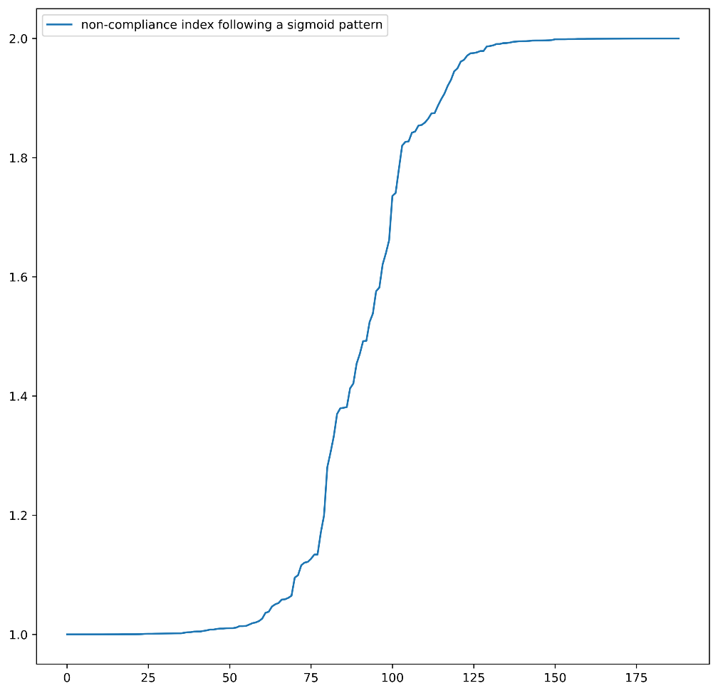

Sensitivity Analysis
Case 1: A Longer Stowing Time
We use Sigmoid Model for Random Distribution $σ\left(x\right)=−\frac{1}{1+e^{−x}}→σ^{′}(x)$
Commonly Used in Statistics
Usage determined by nature of function: $ℝ→$A Custom Range,
reaching the limit at both ends with linear in the middle
Fig. Sigmoid Model Demonstration
55

Slide 56



Sensitivity Analysis
Case 1: A Longer Stowing Time
When considering the comparison on longer stowing time and variance, we define Stable functions as those with Linear graphs. Both the functions of Front to Back and Back to Front are upper convex followed by linear, while Random without obvious patterns. Thus Random boarding is the most sensitive, as it’s the only Unstable graph.
Fig. Comparison on Longer Stowing Time, Variance
56

Slide 57



Sensitivity Analysis
Case 1: A Longer Stowing Time
Random boarding is the most sensitive while Front-to-Back method seems totally not sensitive, as the points on the second graph (random) are farther from the line than that of the other two graphs and thus the goodness of fit is lower.
Fig. Comparison on Longer Stowing Time, Overall Time
57

Slide 58


Sensitivity Analysis
Case 2: Queue Jumping
Both Methods are Sensitive which makes a Big Impact on Total Results, as shown on the graph, the points are irregularly distributed.
Fig. Comparison on Queue Jumping
58

Slide 59



Sensitivity Analysis
Case 3: Reduction of Passengers
Random Boarding is the most Sensitive (Furthest Distribution of Points), Back-to-Front Method still not so sensitive
Fig. Comparison on Reducing Passengers
59

Slide 60
Block division
We divide the multi-aisle aircrafts into several blocks according to aisles
Can unify the models as each block is similar to one-aisle aircraft
Is plausible because there would be no inter-aisle disruption
Our work reduced to finding the best in-block and between-block strategies
Only to find the between-block sequence as we can use the previously shown in-group sequence (similar to one-aisle aircraft strategy)
60

